Slide 1
EVOLUTION
The
CAMERA
of the

Slide 2
CAMERA?
WHAT
is a

Slide 3
According to Wikipedia:
A camera is a device that records/stores images. These images may be still photographs or moving images such as videos or movies. The term camera comes from the camera obscura (Latin for "dark chamber"), an early mechanism for projecting images. The modern camera evolved from the camera obscura.
Cameras may work with the light of the visible spectrum or with other portions of the electromagnetic spectrum. A camera generally consists of an enclosed hollow with an opening (aperture) at one end for light to enter, and a recording or viewing surface for capturing the light at the other end. A majority of cameras have a lens positioned in front of the camera's opening to gather the incoming light and focus all or part of the image on the recording surface. Most 20th century cameras used photographic film as a recording surface, while modern ones use an electronic camera sensor. The diameter of the aperture is often controlled by a diaphragm mechanism, but some cameras have a fixed-size aperture.
The still camera takes one photo each time the user presses the shutter button. A typical movie camera continuously takes 24 film frames per second as long as the user holds down the shutter button, or until the shutter button is pressed a second time.
From its inception, the camera has been instrumental in the recording of still images from then-present surroundings, and further modifications led to the development of motion picture sequences in the late 19th century. Cameras and the exhibition of camera-captured images are widely used in both professional and consumer settings in the 21st century for both mass and interpersonal communication purposes.

Slide 4
According to Wikipedia:
A camera is a device that records/stores images. These images may be still photographs or moving images such as videos or movies. The term camera comes from the camera obscura (Latin for "dark chamber"), an early mechanism for projecting images. The modern camera evolved from the camera obscura.
Cameras may work with the light of the visible spectrum or with other portions of the electromagnetic spectrum. A camera generally consists of an enclosed hollow with an opening (aperture) at one end for light to enter, and a recording or viewing surface for capturing the light at the other end. A majority of cameras have a lens positioned in front of the camera's opening to gather the incoming light and focus all or part of the image on the recording surface. Most 20th century cameras used photographic film as a recording surface, while modern ones use an electronic camera sensor. The diameter of the aperture is often controlled by a diaphragm mechanism, but some cameras have a fixed-size aperture.
The still camera takes one photo each time the user presses the shutter button. A typical movie camera continuously takes 24 film frames per second as long as the user holds down the shutter button, or until the shutter button is pressed a second time.
From its inception, the camera has been instrumental in the recording of still images from then-present surroundings, and further modifications led to the development of motion picture sequences in the late 19th century. Cameras and the exhibition of camera-captured images are widely used in both professional and consumer settings in the 21st century for both mass and interpersonal communication purposes.
In short,
A camera is anything that can record/store images.

Slide 5
and
They come…

Slide 6
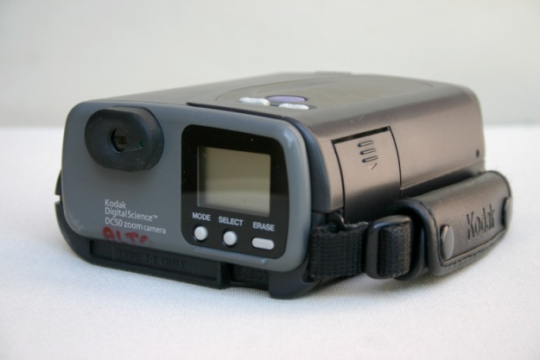
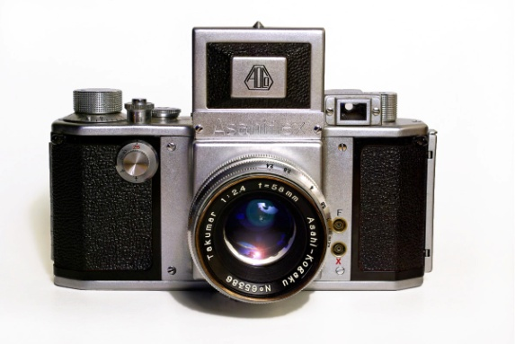
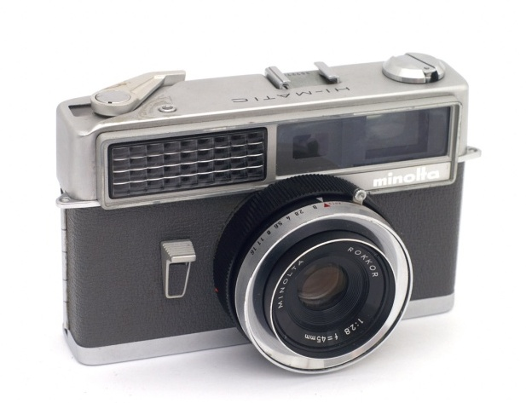
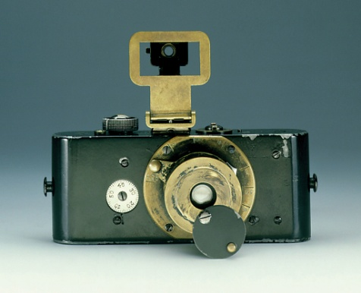
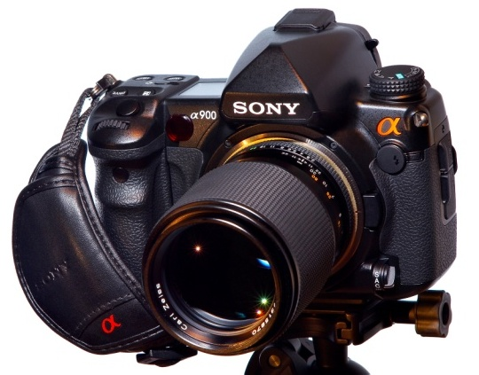
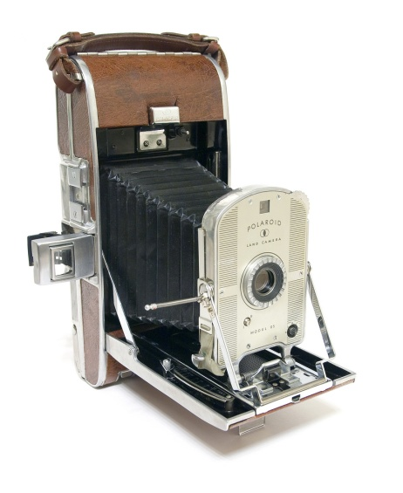
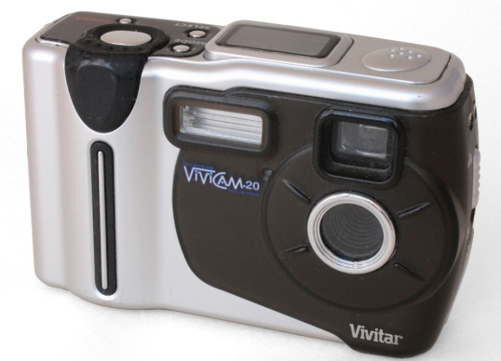
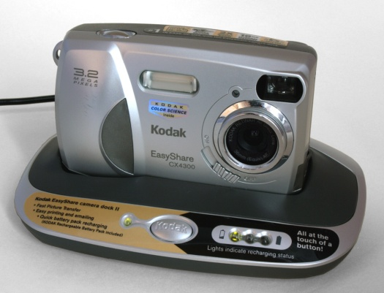
…in all
shapes
sizes.
and

Slide 7
It all started with
one guy
though…

Slide 8
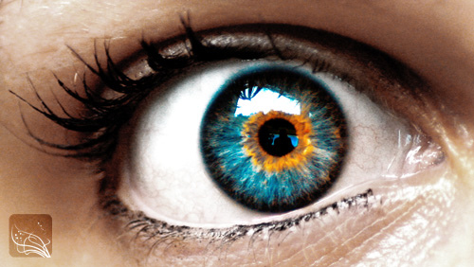
Eye
The
TIME: (Since it existed)

Slide 9
OK.
Maybe the eye isn’t really the Adam and Eve of modern cameras.

Slide 10
This guy is:

Slide 11
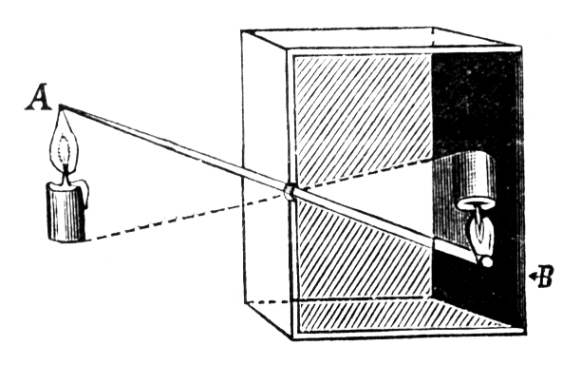
CAMERA OBSCURA
TIME: (11th century – )

Slide 12
CAMERA OBSCURA
TIME: (11th century – )
How it worked:

Slide 13
CAMERA OBSCURA
TIME: (11th century – )
The light from an object (A) passes through a pinhole, which shows up in the camera obscura’s other side as an inverted image (B).
How it worked:

Slide 14
It’s more of a projector than a camera actually.

Slide 15
It’s more of a projector than a camera actually.
Since it can’t really store the image.

Slide 16
It’s more of a projector than a camera actually.
Since it can’t really store the image.
It just projects it.

Slide 17
How your great-
grandpa’s projector
looked like.

Slide 18
The very first
TRUE
CAMERA

Slide 19
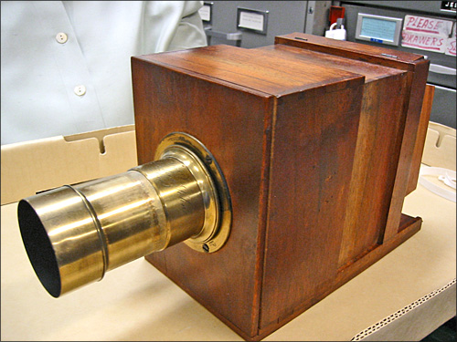
is the
TIME: (1830s+)
Daguerreotype

Slide 20
is the
TIME: (1830s+)
Daguerreotype
(I don’t know the pronunciation either.)

Slide 21
Which uses a special copper plate to capture the light from the image.
The only problem is:

Slide 22
Which uses a special copper plate to capture the light from the image.
The only problem is:
It takes up to
15 minutes
of EXPOSURE
to fully capture the image.

Slide 23
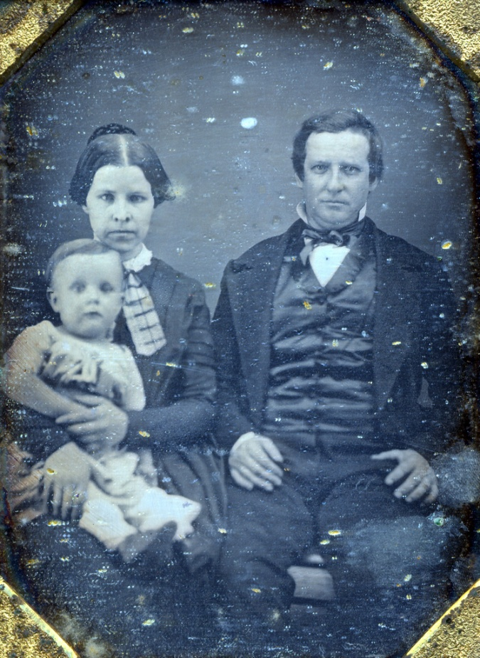
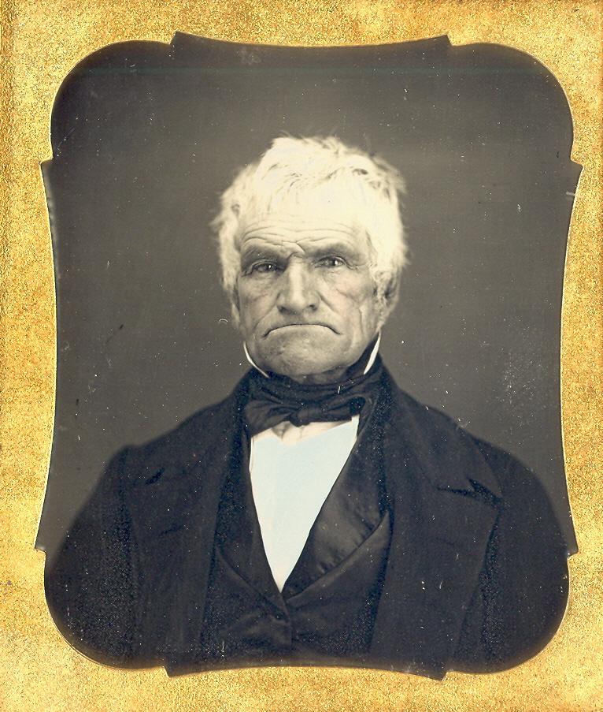
Makes you feel sorry for these guys:

Slide 24
Makes you feel sorry for these guys:
Notice the frowns on their faces.

Slide 25
EMULSION PLATES
Good thing
were INVENTED.
TIME: (1850s+)

Slide 26
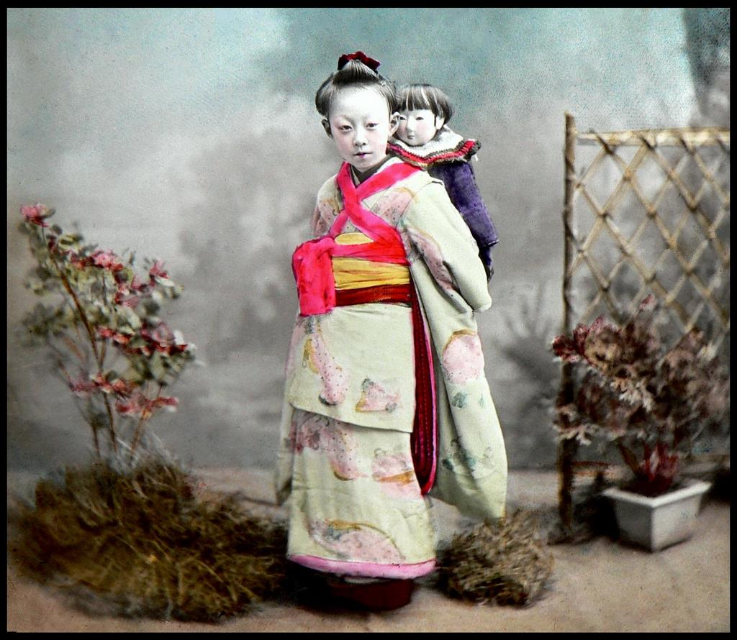
EMULSION PLATES
Good thing
were INVENTED.
TIME: (1850s+)
which only take
2-3 seconds
of exposure time.

Slide 27
They had to be made
on the spot
though,

Slide 28
DRY PLATES
So
were born.
TIME: (1850s+)

Slide 29
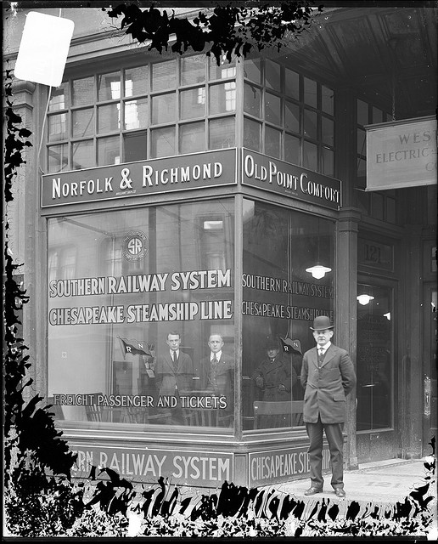
DRY PLATES
So
were born.
TIME: (1850s+)
which can be stored for future use.

Slide 30
These cameras were
BIG.

Slide 31
And looked like the monster tripods from the War of the Worlds movie.

Slide 32
The world needed

Slide 33
portable cameras
TIME: (1880s+)

Slide 35
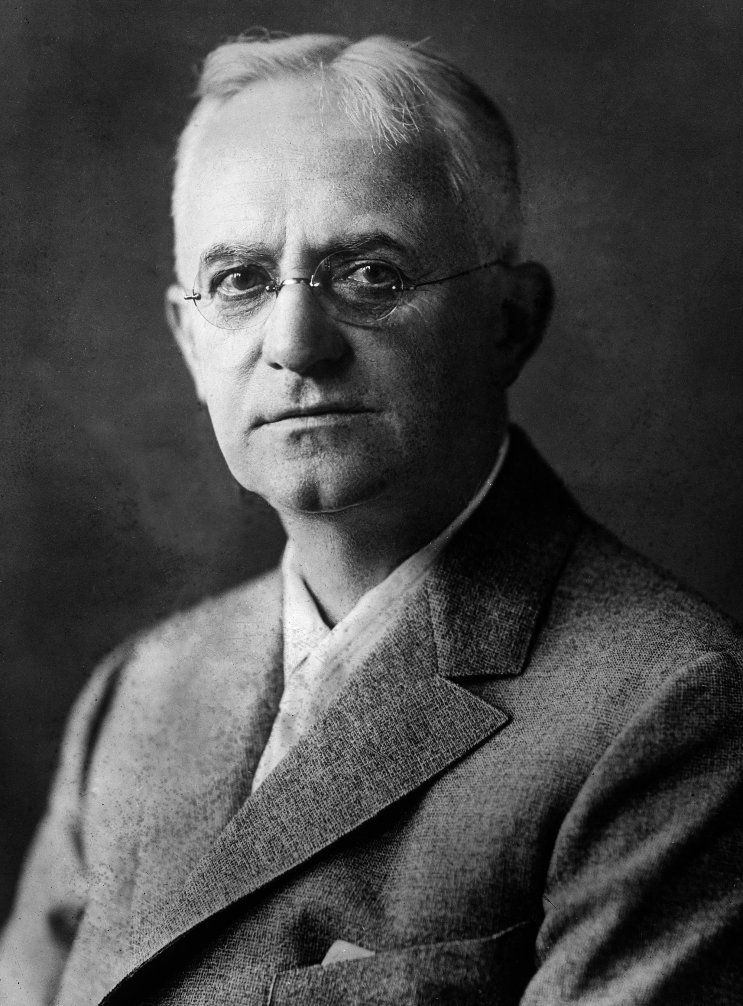
Hi, I’m George Eastman.

Slide 36
You should thank me.

Slide 37
I created flexible roll films.

Slide 38
Which made portable cameras possible.

Slide 39
HELL YEAH!

Slide 40
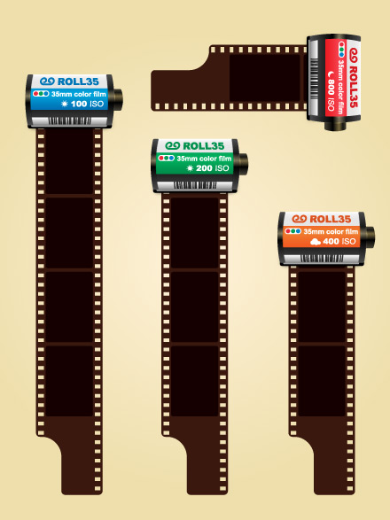
The
35mm Film
TIME: (1913+)
Became THE
STANDARD
for cameras and is still being used NOW.

Slide 41
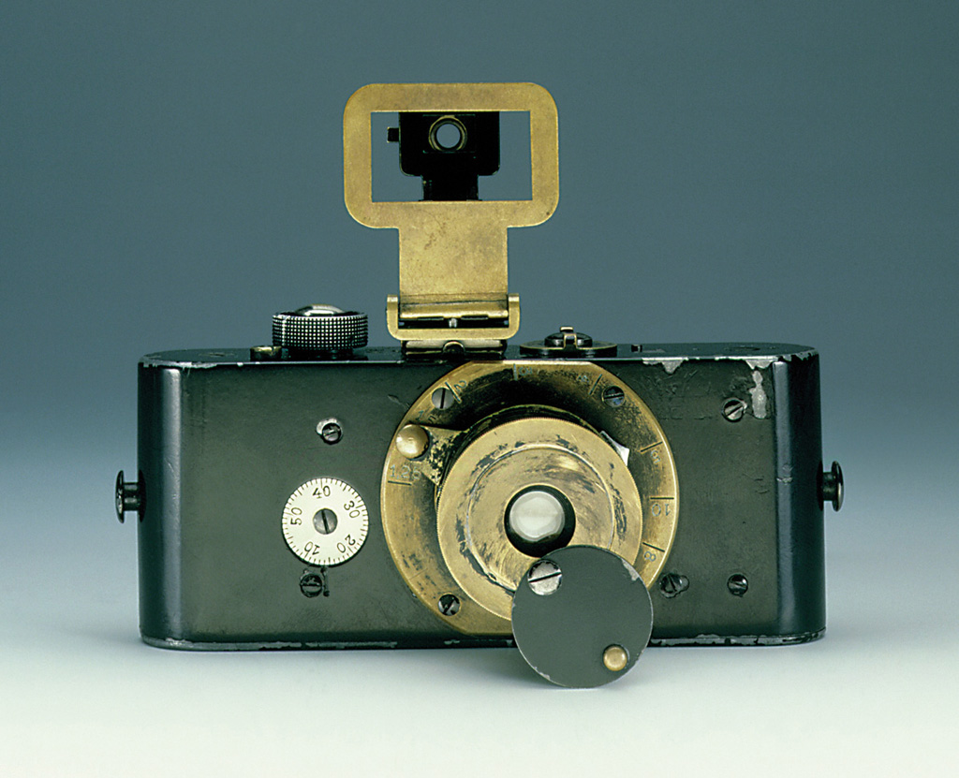
The
FIRST
35mm film
camera
Ur-leica
TIME: (1914)

Slide 42
Over 30 years later…

Slide 43
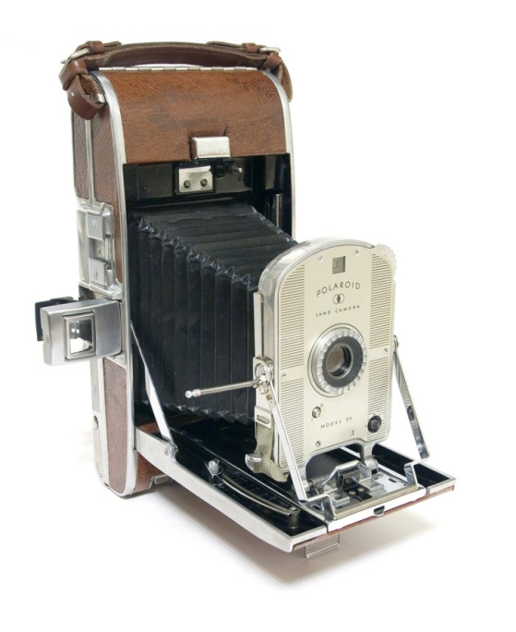
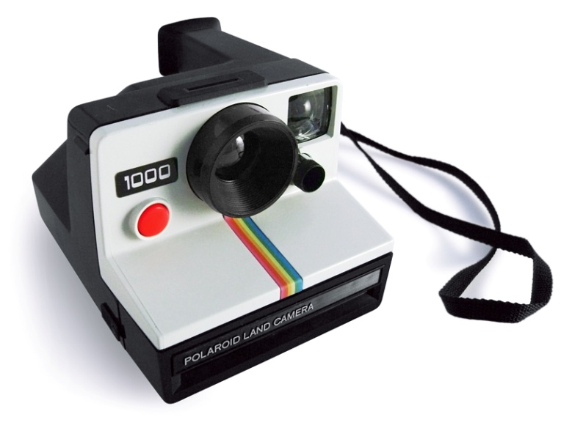
POLAROID CAMERAS
TIME: (1948)
were born.
which created…

Slide 44
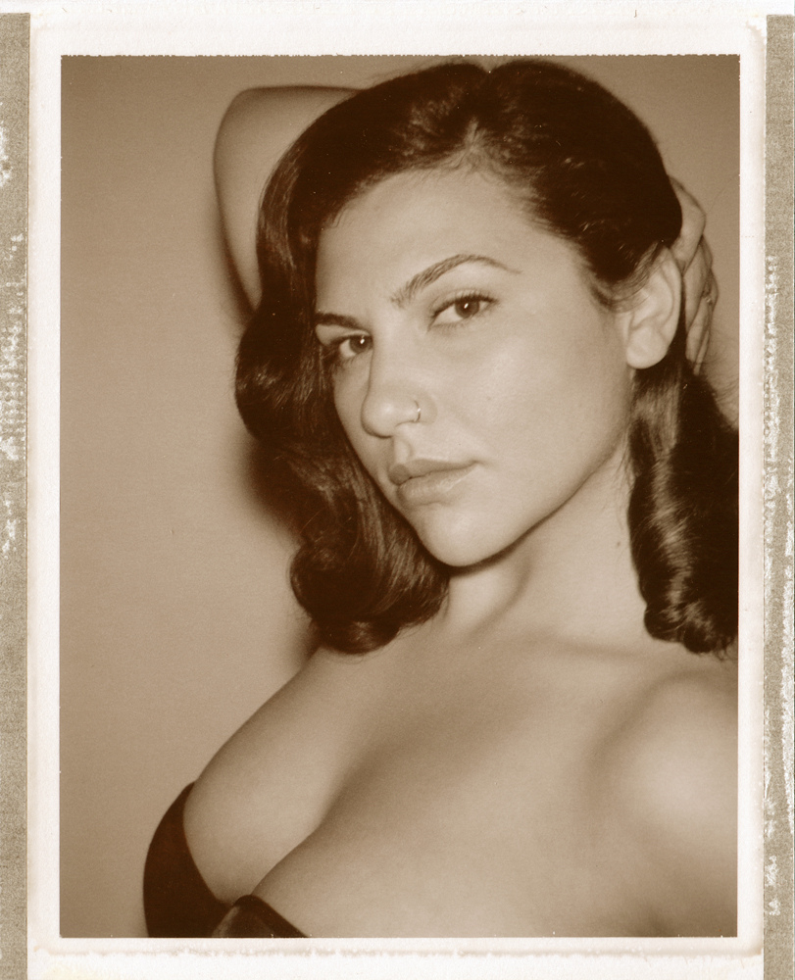
INSTANT
IMAGES

Slide 45
and the undying HABIT of crowding around the camera to see how the shot looked like.

Slide 46
Photos didn’t really

Slide 47
come out
Photos didn’t really

Slide 48
come out
Photos didn’t really
EXACTLY

Slide 49
come out
Photos didn’t really
EXACTLY
like what you’d see

Slide 50
come out
Photos didn’t really
EXACTLY
like what you’d see
in the viewfinder though.

Slide 51
What happened to my picture???

Slide 52
SO…

Slide 53
SLR CAMERAS
TIME: (1948)
were created.

Slide 54
SLR CAMERAS
TIME: (1948)
were created.
FIRST
which were the
WYSIWYG
(What you see is what you get)
CAMERAS

Slide 55
Everything was going well for our photographers,

Slide 56
UNTIL…

Slide 57
TIME: (1991)
DIGITAL CAMERAS
Which have greatly
CHANGED
the way cameras work.

Slide 58
Now, there’s no
NEED
to get perfect photos.

Slide 60
You can easily DELETE ugly shots
and just take another one.

Slide 61
THANKS to technology,

Slide 62
Cameras can now be found

Slide 63
Cameras can now be found
ANYWHERE

Slide 64
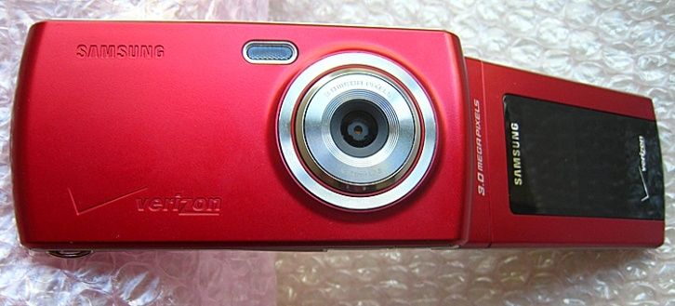
PHONES

Slide 65
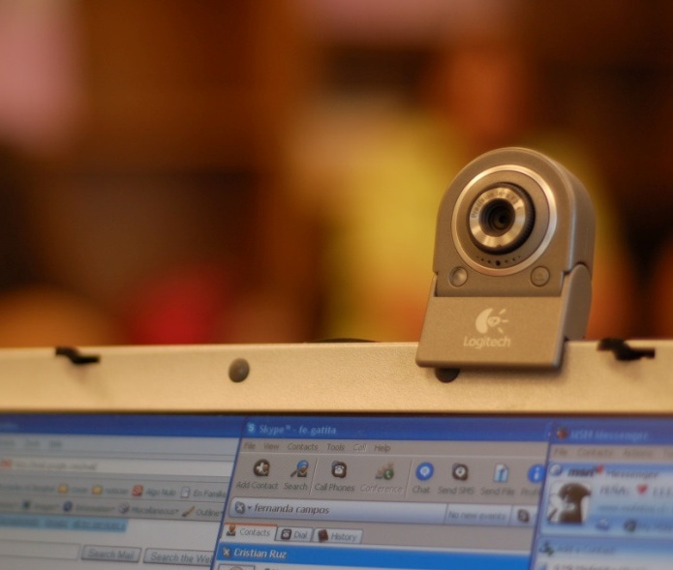
PHONES
COMPUTERS

Slide 66
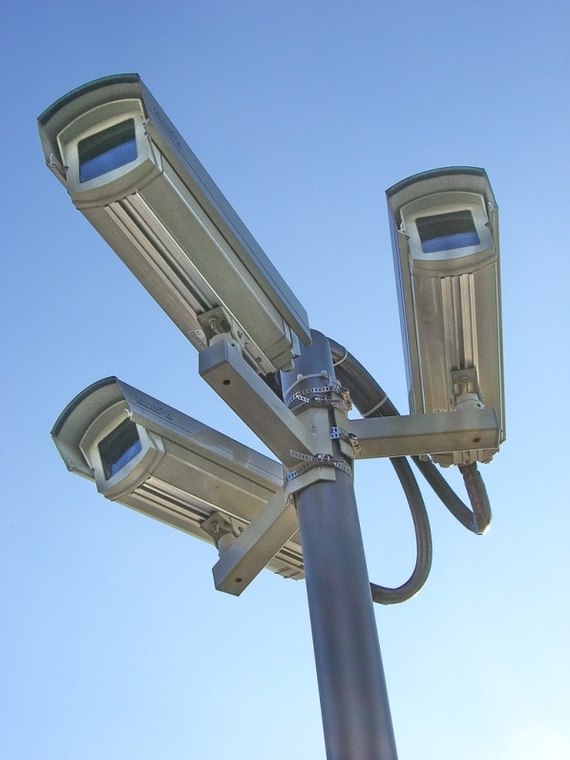
PHONES
ANYWHERE
COMPUTERS

Slide 67
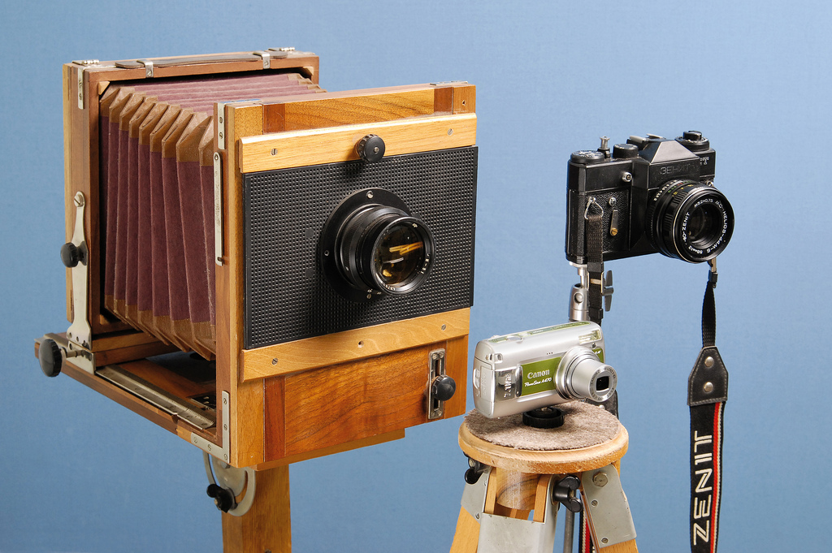
Cameras have EVOLVED.

Slide 68
What next?

Slide 69
Image Sources:
Slide | Source
6 | http://www.flickr.com/photos/captkodak/271906449/ http://www.flickr.com/photos/ziopaopao/2746854104/ http://commons.wikimedia.org/wiki/File:Asahiflex_IIB_IGP3456.jpg http://commons.wikimedia.org/wiki/File:Ur_Leica.jpg http://www.flickr.com/photos/26831083@N00/3008842759 http://www.flickr.com/photos/awcam/5131324203/ http://www.flickr.com/photos/awcam/4983483756/in/pool-46195334@N00/ http://www.flickr.com/photos/arkku/4002337761/
8 | http://www.flickr.com/photos/darkpatator/2046061315/
11,12,13 | http://commons.wikimedia.org/wiki/File:Camera_obscura_1.jpg
17 | http://commons.wikimedia.org/wiki/File:Camera_obscura_2.jpg
19,20 | http://www.flickr.com/photos/keithwj/6332554/
23,24 | http://www.flickr.com/photos/55333013@N00/3360347864/ http://www.flickr.com/photos/mirrorimagegallery/3842875058/
26 | http://www.flickr.com/photos/24443965@N08/3748140765/
29 | http://www.flickr.com/photos/umbclibrary/4010857481/
31 | http://commons.wikimedia.org/wiki/File:CityParkPhotographerNOLA2.jpg
34 | http://commons.wikimedia.org/wiki/File:Kodak_ad_1888.GIF

Slide 70
Image Sources:
Slide | Source
35-39 | http://commons.wikimedia.org/wiki/File:GeorgeEastman2.jpg
40 | http://www.flickr.com/photos/horiavarlan/4293865266/
41 | http://commons.wikimedia.org/wiki/File:Ur_Leica.jpg
43 | http://www.flickr.com/photos/26831083@N00/3008842759 http://www.flickr.com/photos/galessa/2153964137/
44 | http://www.flickr.com/photos/michaelraso/4740838087/
45 | http://www.flickr.com/photos/chriswho/2768871615/
51 | http://www.flickr.com/photos/62337512@N00/4335060317/
53,54 | http://commons.wikimedia.org/wiki/File:Asahiflex_IIB_IGP3456.jpg
57 | http://www.flickr.com/photos/ziopaopao/2746854104/ http://www.flickr.com/photos/awcam/5131324203/
59 | http://www.flickr.com/photos/virgu/12496426/
64,65,66 | http://www.flickr.com/photos/theamarand/2454585655/ http://www.flickr.com/photos/mofetos/435827739/ http://www.flickr.com/photos/cbs_fan/1029630568/
67 | http://www.flickr.com/photos/27429206@N02/3857839985/

