Slide 1
Designing with Type
Photoshop CS4

Slide 2
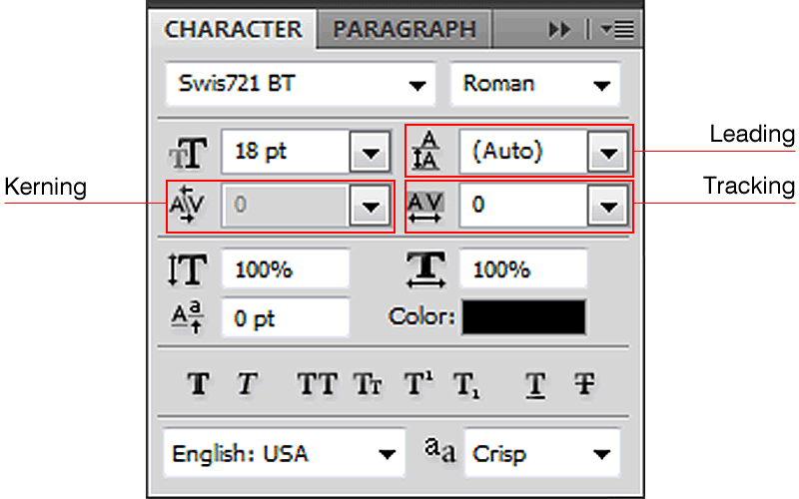
Character Panel

Slide 3
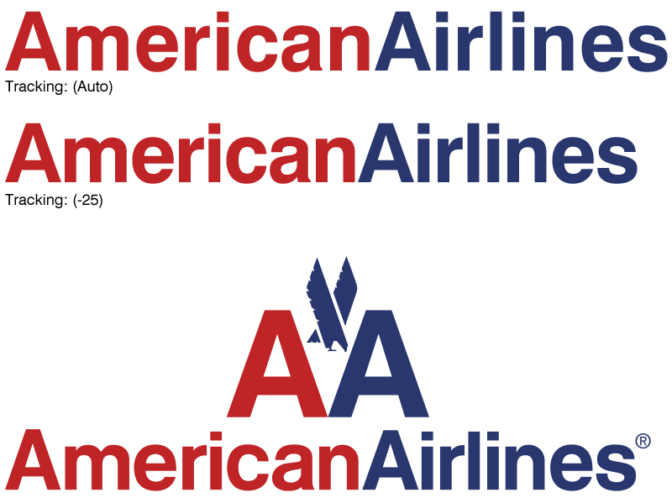
Tracking

Slide 4

Tracking

Slide 5
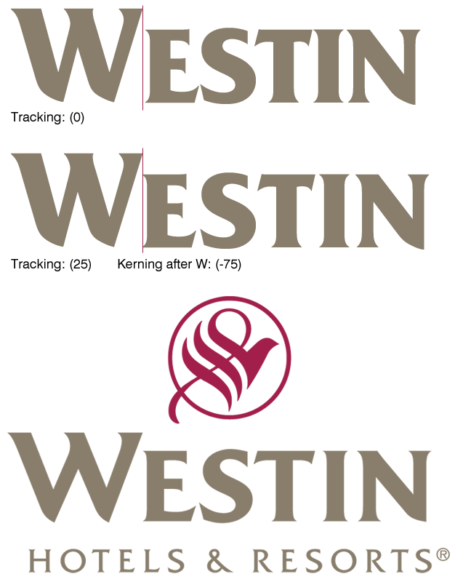
Kerning

Slide 6
Kerning

Slide 7
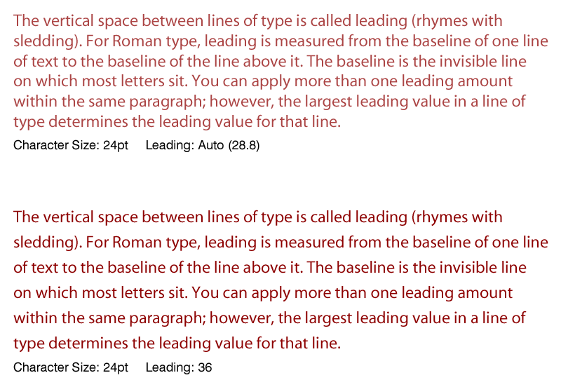
Leading

Slide 8
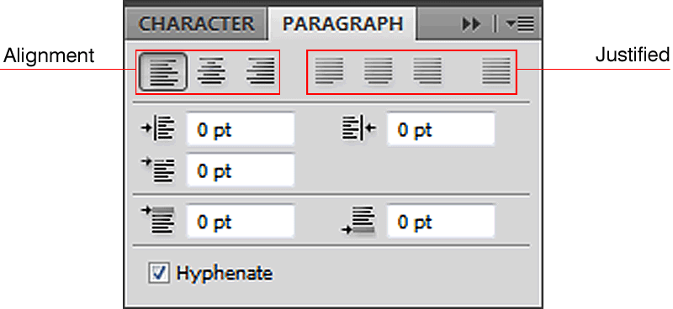
Paragraph Panel

Slide 9
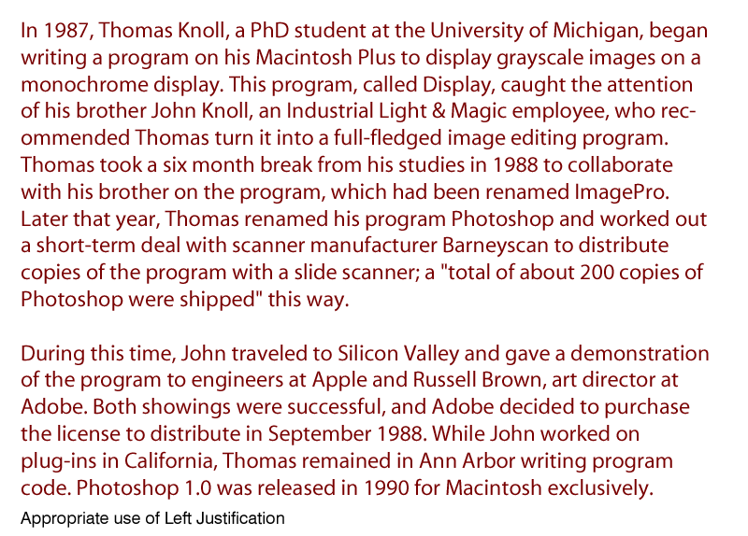
Left-Justified

Slide 10
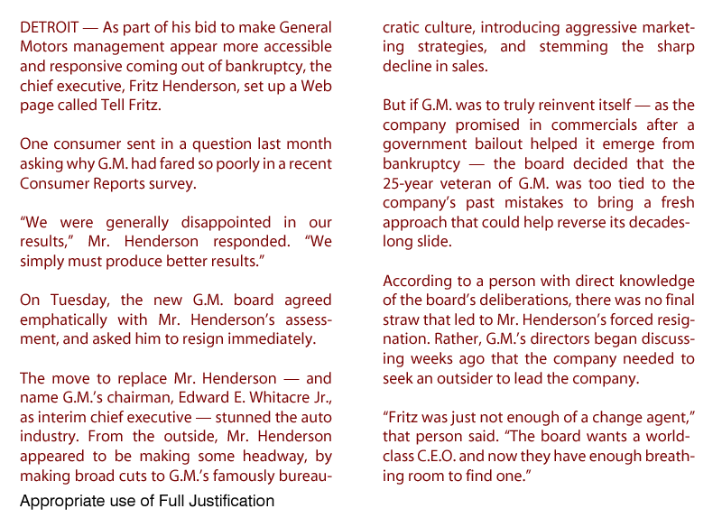
Justified

Slide 11
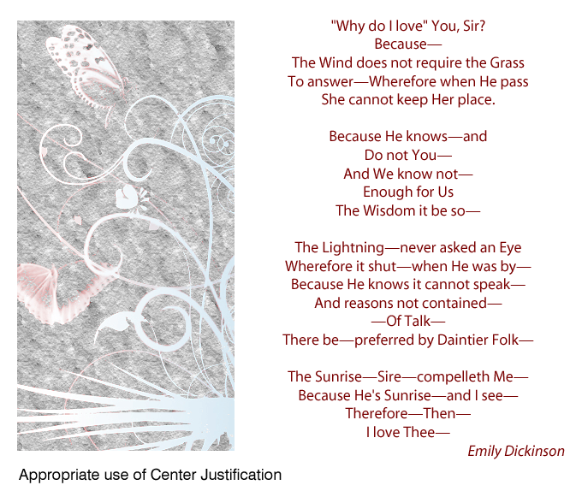
Center-Justified

Slide 12
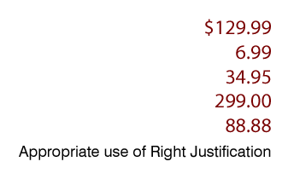
Right-Justified

Slide 13
Right-Justified

Slide 14
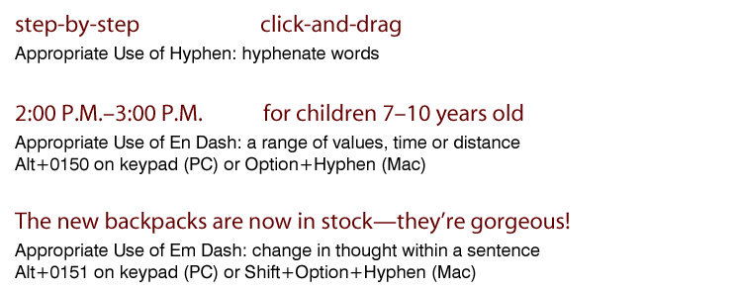
Using the Correct Dash

Slide 15
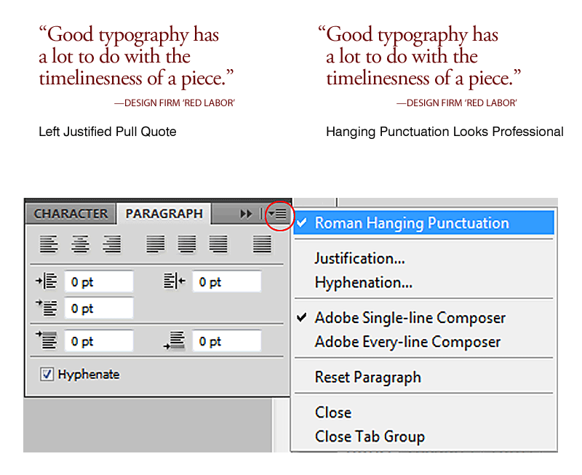
Hanging Punctuation

Slide 16
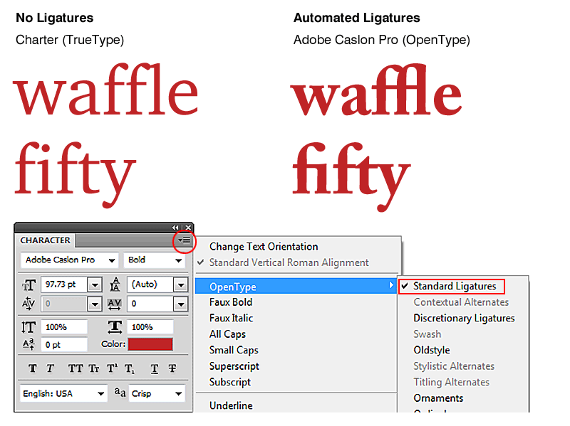
Ligatures

Slide 17
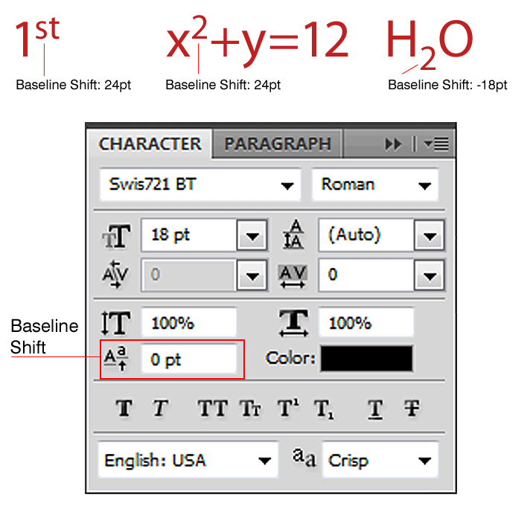
Baseline Shift

Slide 18
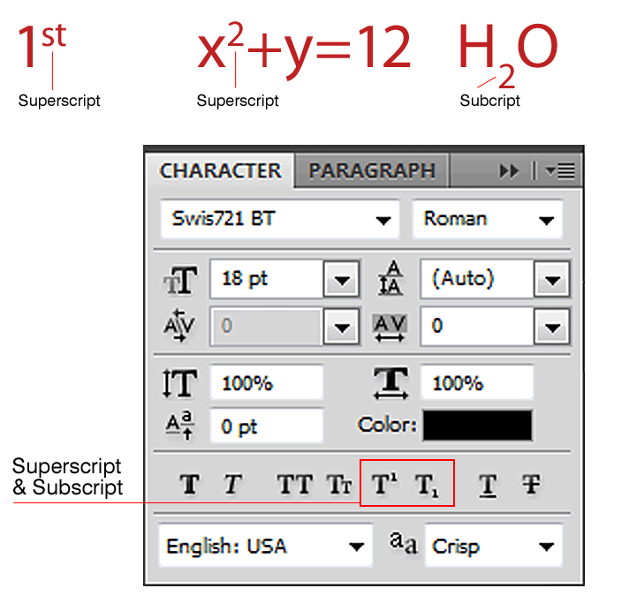
Superscript and Subscript

Slide 19
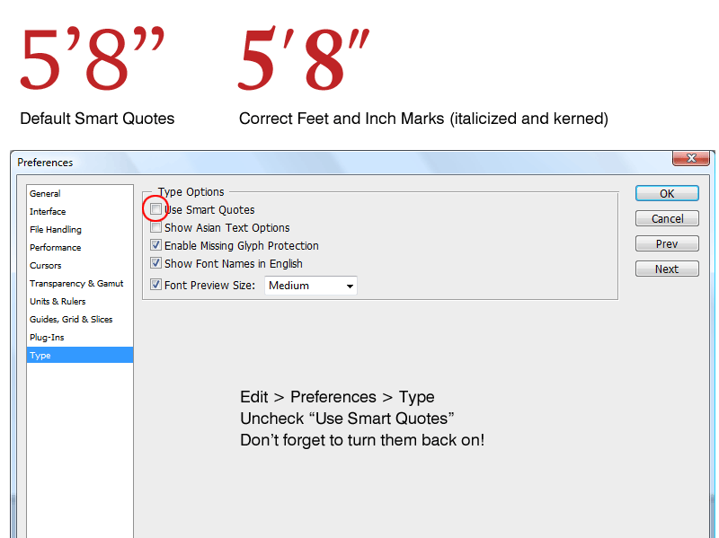
Feet and Inch Marks

Slide 20
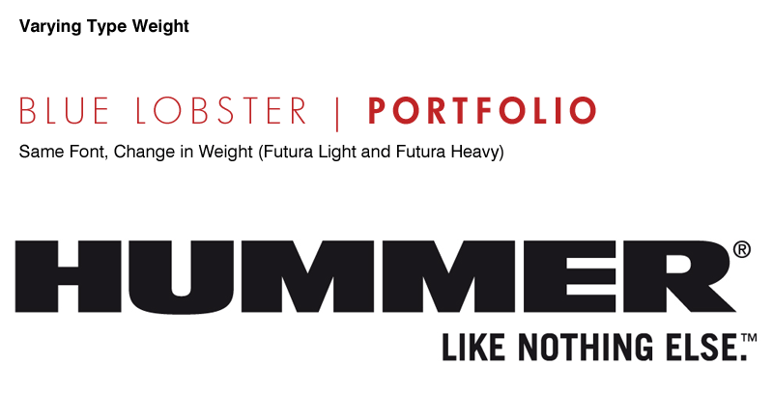
Designing with Type

Slide 21

Designing with Type

Slide 22
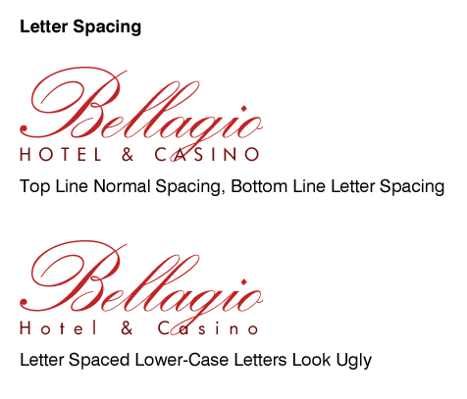
Designing with Type

Slide 23
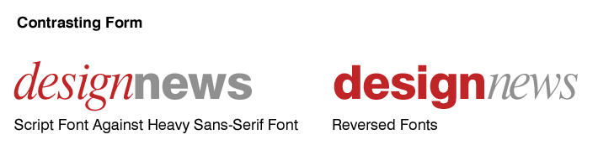
Designing with Type

Slide 24
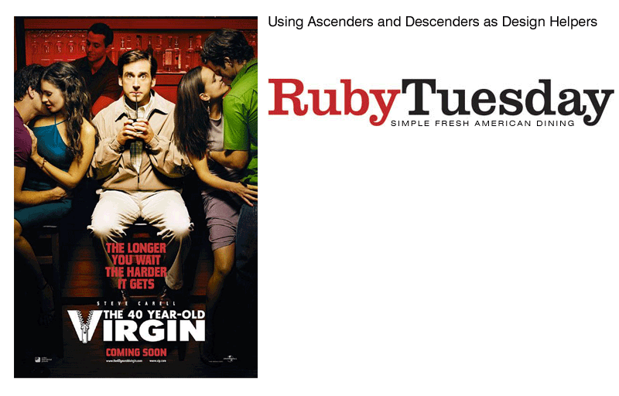
Designing with Type

Slide 25
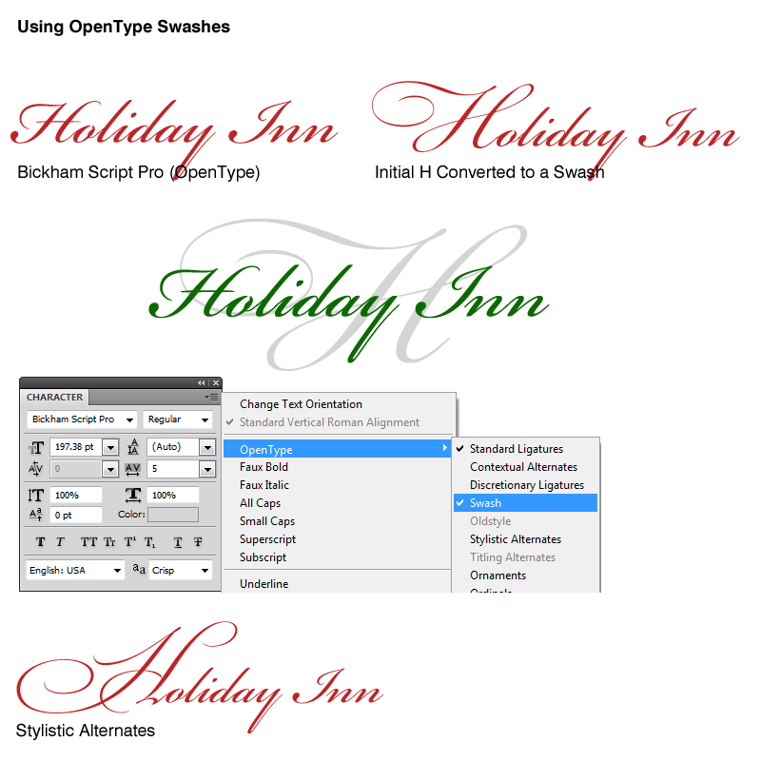
Swashes

Slide 26
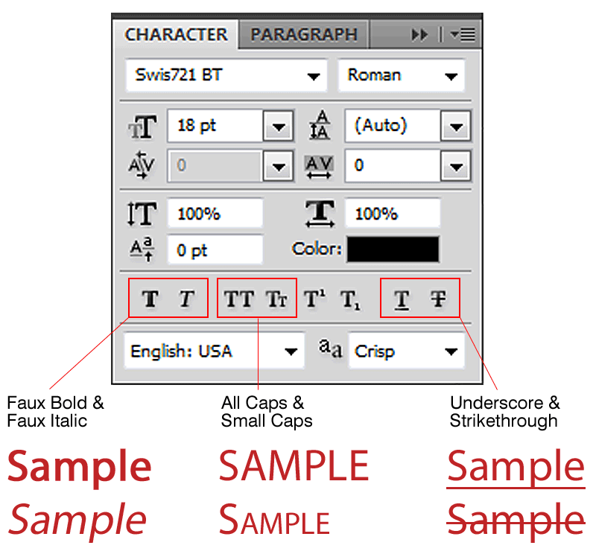
Character Panel Extras

Slide 27
Character Panel Extras

Slide 28
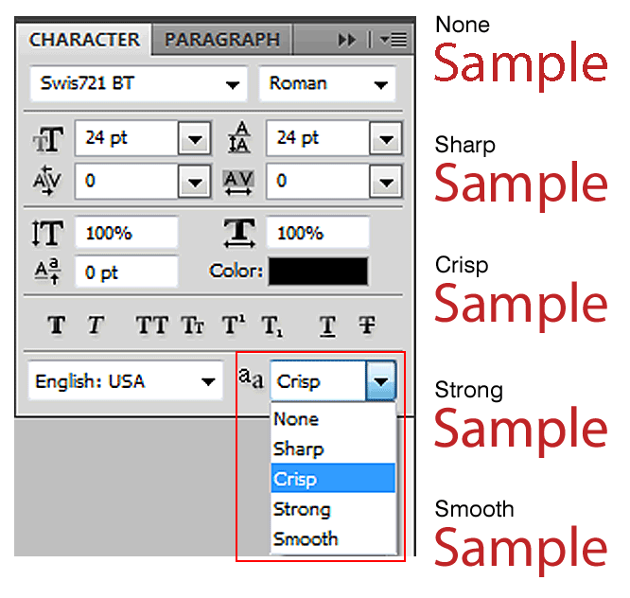
Anti-Alias
Methods
Anti-Alias: to smooth text so the edges of characters that appear onscreen look less jagged.

Slide 29
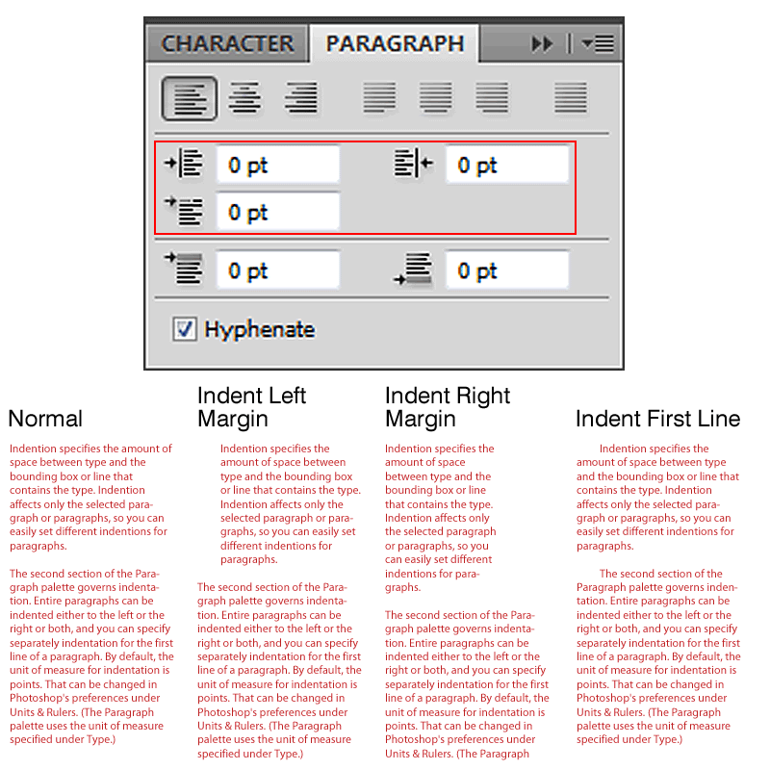
Paragraph Panel Extras
Indentations

Slide 30
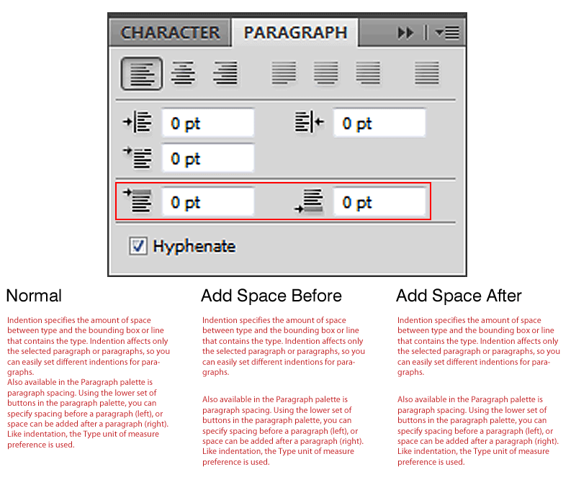
Paragraph Panel Extras
Space Before and Space After

Slide 31
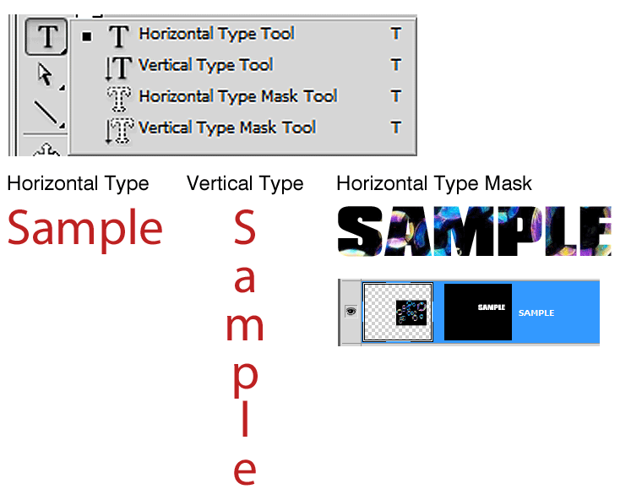
Type Tools

Slide 32
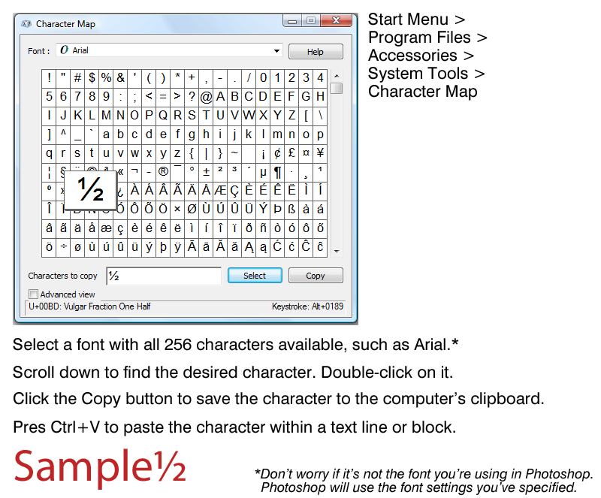
Special Characters on the PC

Slide 33
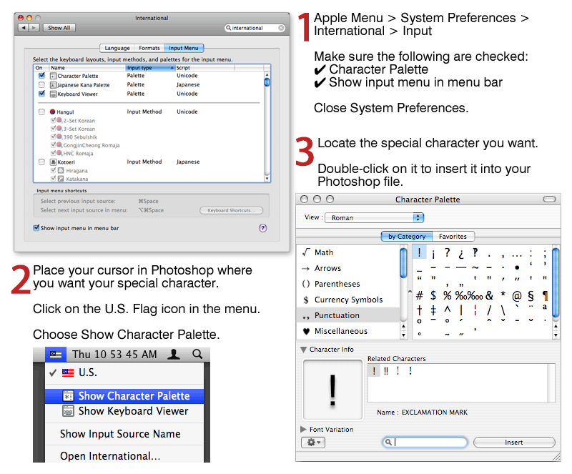
Special Characters on the Mac

Slide 34
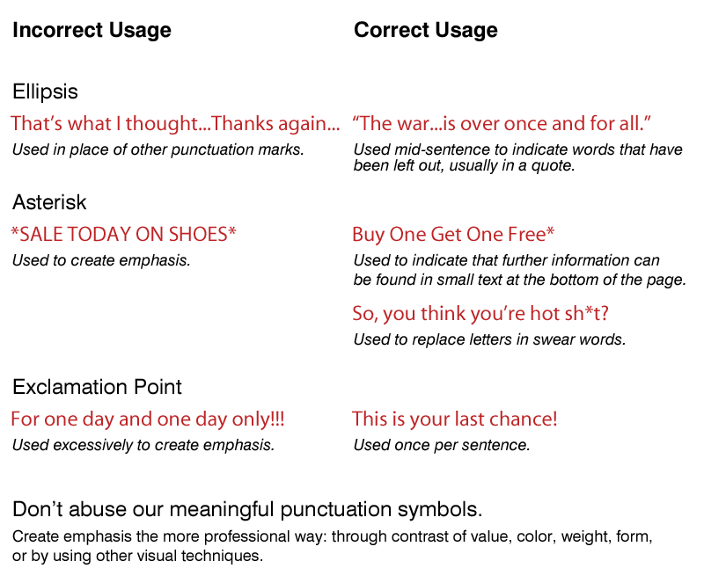
Correct Punctuation Usage

